Slide 1
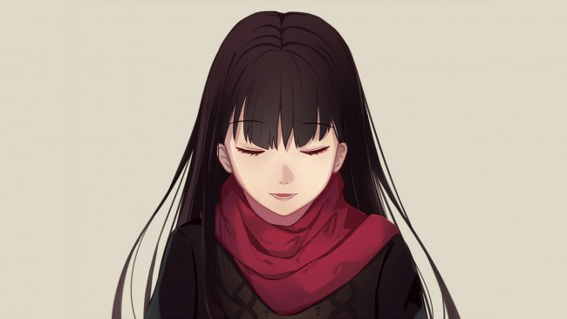
Slide 1
I just need
myself
Baneen Al Fartusi

Slide 2
Slide 2
Victoria, who was a 25 – years old girl, was disabled, she couldn’t see.
She lived in a very small house, with her cat, Lily, who was like a sidekick, she helped her to know her way and cross the street.
Lily came crawling on Victoria, while she was sleeping.
“Lily!” said Victoria.
“Good morning Lily.”
Lily helped Victoria to go down the stairs, and leaded her to the kitchen. Victoria baked toast and cheese for breakfast, and put some cat’s food in Lily’s plate.
They finished breakfast, then Lily helped Victoria to go to the shower room.
She had a shower, brushed her teeth, and got dressed, it was time to go shopping.

Slide 3
Slide 3
Victoria and her cat went to the super market.
“Lily, find me some apples, and put 45 apples in the basket.” Lily put 45 apples in the basket.
“and 24 oranges, 56 cucumbers, and 35 peaches.”
She put everything in the basket.
“can you lead me to the fish section?”
Lily leaded her to the fish section.
“now take a big – large fish.”
Lily took a big fish and put it in the basket.
After shopping they were heading home, but, when they were crossing the street, a fast car came, and the cat saved Victoria, but she died instead.

Slide 4
Victoria carried her cat in her arms, and cried.
“Lily! Lily! Please, no no, you are cold, no please, lily, wake up, lily!”
Tears were down her cheeks.
She went to the vet, without help, and took her cat, but there was no hope, the nurse took the cat and buried her.
Victoria went home, as she felt her tears dry.
But after a while, she learned how to cross the street and go to anywhere.
“Life will not stop here, I’m strong, and I’ll keep going, I just need myself.

